Slide 1
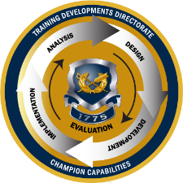
TJAGLCS Training Package
Discipline in the Civil Service System
December 2024

Slide 2
The information provided throughout this training aid does not, and is not intended to, constitute legal advice; instead, all information, laws, statues, content, and materials for this training aid are for general informational purposes only. This training aid may not constitute the most up-to-date legal or other relevant legal information. Judge Advocates need to conduct their own due diligence through independent further legal research on any specific legal issue contained in this training package. No reader, user, or trainee of this product should act or refrain from acting based on information from this training aid without first seeking legal advice from an attorney in the relevant jurisdiction.

Slide 3
DISCIPLINARY ACTIONS FOR CIVILIANS

Slide 4
The Conventional Wisdom
Disciplining civilian employees is:
Too hard
Takes too long
The reality: Civilian employee discipline is essential to readiness and good order and discipline
BOTTOM LINE: YOU MUST
BECOME CONFIDENT IN THE PROCESS
Is ineffective
Just cannot be done

Slide 5
Keys to Success
Patience – this is labor intensive (time consuming)
Attention to detail (documentation)
Team effort (support staff)
Effective communication
Consistent, deliberate, transparent

Slide 6
Your Management Team
Workers
Compensation
Specialist
Manager /
Supervisor
Labor
Counselor
Civilian Human Resources Agency (CHRA)
Labor Mgmt Employee Relations (LMER) Specialist
Equal Employment Opportunity Manager
USALSA
&
DOJ
Employee Assistance Program Counselor
Union?
Disability Program Manager

Slide 7
Performance / Misconduct
Chapter 43
Chapter 75
“Performance which fails to meet established performance standards in one or more critical elements of the employee’s position”
“Any type of behavior or action that adversely effects the efficiency of the service”
i.e. Performance Element
i.e. On or off duty misconduct, AWOL
5 C.F.R. Part 752
5 C.F.R. Part 432

Slide 8
Chapter 43 Process Performance
Unacceptable performance
Performance Improvement Plan (PIP)
Employee Fails
Issue Notice of Proposal
Employee Responds within 7 days
Deciding Official Issues Notice of Decision
Notice and Opportunity to improve
12 months
Element not met
Summary of PIP
Right to respond, representation, and appeal
Action
Justification
Appeal rights

Slide 9
Chapter 75 Process Misconduct/Generic Poor Performance
Misconduct/
Generic Poor Performance
Issue Notice of Proposal
Employee Responds within 7 days
Deciding Official Issues Notice of Decision
Specific instances of poor performance/generic misconduct
Right to respond/representation
Appeal Rights
Decision
Justification
Appeal rights

Slide 10
How to Decide on Punishment: The Douglas Factors
All reasonable factors must be considered by the Deciding Official (appropriate penalty)
A list of 12 factors including:
Nature & seriousness of offense
Past disciplinary & work record
Consistent penalty w/ (other employees)(Table of Penalties)
Properly put on notice
Rehabilitation potential
Mitigating circumstances
Failure to consider could mean MSPB modifies penalty (Ch. 75 only)
Source: Douglas v. Veterans Administration, 5 M.S.P.R. 280, 305-306 (1981)

Slide 11
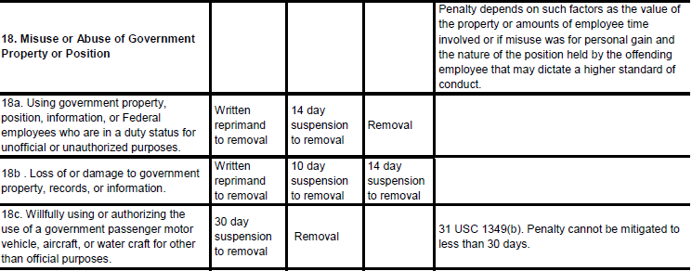
How to Decide on Punishment: The Table of Penalties
Source: AR 690-752, Table 3-1, published 10 February 2022

Slide 12
Avoid “Ward” Violations: Provide Complete Notice
Ward violation: Employee lacks notice of new and material information that the Deciding Official relies upon
Best practice: if Deciding Official becomes aware of new information, provide new notice to the employee

Slide 13
Progressive vs. Punitive Discipline
Suspension
1-14 days OR 15 + days*
Reduction*
Counseling, Warning, Reprimand
Removal*
Progressive Discipline (most cases) - select the least severe penalty necessary to correct behavior.
Without duties or pay
*Appealable to MSPB
Punitive Discipline - select most severe penalty warranted to deter future misconduct.

Slide 14
Need Training Materials?
Have Training Materials?
Questions?
Contact Us!
TJAGLCS-training@army.mil

